Slide 1
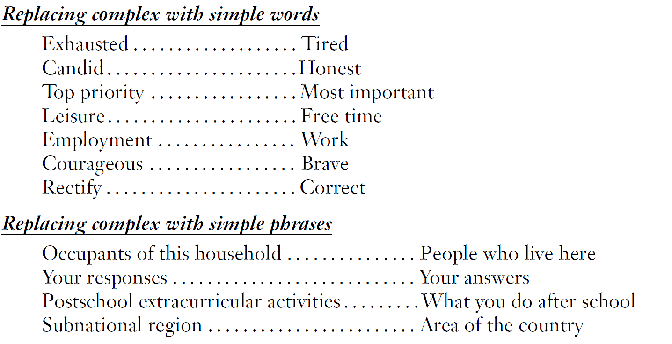
Use Simple, Familiar Language

Slide 2
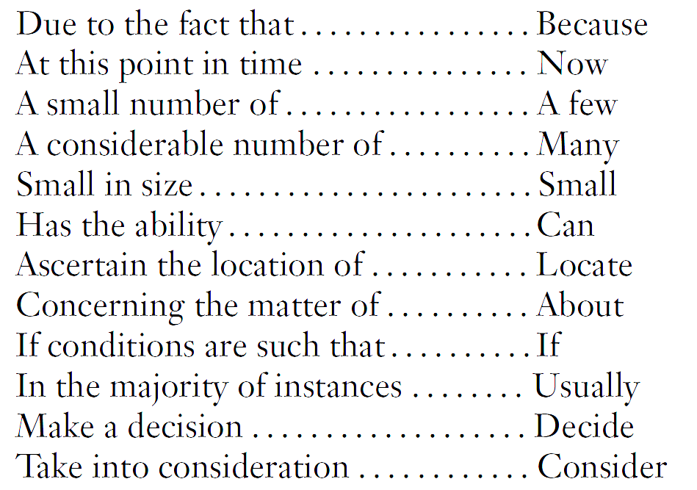
Use Few Words to Pose Questions
4. How many people were living or staying at this residence on Saturday March 3rd, 2000? To make sure each person in the United States is counted only once, it is very important to:
Include everyone who lives here whether related
to you or not, and anyone staying temporarily who
has no permanent place to live;
But do not include anyone away at college,
away in the Armed Forces, in a nursing home,
hospice, mental hospital, correctional facility,
or other institution.
Avoid Wordy Expressions
Number people at residence
Notes:
Note to remember during presentation:
Use as few words as possible to pose the question
Eliminating wordy and redundant expressions

Slide 3


Formulating Questions
5. From which one of the following did you first learn about the tornado?
Radio
Television
Someone at work
While at home
While traveling to work
5. From which one of these sources did you first hear about the tornado?
Radio
Television
Internet
Other please specify____________
6. Where were you when you first heard about the tornado? Please select one of the following.
At work
At home
Traveling to work
Other please specify____________
Key Points
Ensure response options are exhaustive and mutually exclusive
If ambiguous, specify that one answer choice should be selected

Slide 4
Formulating Questions
7. Do you favor or oppose not allowing the state to raise taxes without approval of 60% of the voters?
Favor
Oppose
7. Do you favor or oppose requiring 60% approval by voters in order to raise state taxes?
Favor
Oppose
Key Points
Reduce complexity
Ensure “yes” means yes, and “no” means no

Slide 5
Formulating Questions
8. How satisfied are you with your decision to attend this university?
5 Very satisfied
4
3
2
1 Very dissatisfied
Prefer not to answer
8. How satisfied or dissatisfied are you with your decision to attend this university?
Very satisfied
Somewhat satisfied
Neural
Somewhat dissatisfied
Very dissatisfied
Prefer not to answer
Visual midpoint
Conceptual midpoint
Key Points
Label all response options; avoid using numbers
Ensure even spacing between response options
Align conceptual and visual mid point; may separate non-substantive choices
Use positive and negative side in question stem; for unipolar scales use “if at all”

Slide 6
Formulating Questions
9. Please rate the following on a scale of 1 (very dissatisfied) to 10 (very satisfied):
 | 1 | 2 | 3 | 4 | 5 | 6 | 7 | 8 | 9 | 10
Q1 ….. | ⃝ | ⃝ | ⃝ | ⃝ | ⃝ | ⃝ | ⃝ | ⃝ | ⃝ | ⃝
Q2 ….. | ⃝ | ⃝ | ⃝ | ⃝ | ⃝ | ⃝ | ⃝ | ⃝ | ⃝ | ⃝
Q3….. | ⃝ | ⃝ | ⃝ | ⃝ | ⃝ | ⃝ | ⃝ | ⃝ | ⃝ | ⃝
Q4 ….. | ⃝ | ⃝ | ⃝ | ⃝ | ⃝ | ⃝ | ⃝ | ⃝ | ⃝ | ⃝
Q5….. | ⃝ | ⃝ | ⃝ | ⃝ | ⃝ | ⃝ | ⃝ | ⃝ | ⃝ | ⃝
Q6 ….. | ⃝ | ⃝ | ⃝ | ⃝ | ⃝ | ⃝ | ⃝ | ⃝ | ⃝ | ⃝
Q7 ….. | ⃝ | ⃝ | ⃝ | ⃝ | ⃝ | ⃝ | ⃝ | ⃝ | ⃝ | ⃝
Q8….. | ⃝ | ⃝ | ⃝ | ⃝ | ⃝ | ⃝ | ⃝ | ⃝ | ⃝ | ⃝
Q9 ….. | ⃝ | ⃝ | ⃝ | ⃝ | ⃝ | ⃝ | ⃝ | ⃝ | ⃝ | ⃝

Slide 7
Formulating Questions
9. Please rate your satisfaction or dissatisfaction for each question below:
 | Very Dissatisfied | Dissatisfied | Neither satisfied nor dissatisfied | Satisfied | Very Satisfied
Q1 ….. | ⃝ Very Diss. | ⃝ Diss. | ⃝ Neither | ⃝ Sat. | ⃝ Very Sat.
Q2 ….. | ⃝ Very Diss. | ⃝ Diss. | ⃝ Neither | ⃝ Sat. | ⃝ Very Sat.
Q3….. | ⃝ Very Diss. | ⃝ Diss. | ⃝ Neither | ⃝ Sat. | ⃝ Very Sat.
Q4 ….. | ⃝ Very Diss. | ⃝ Diss. | ⃝ Neither | ⃝ Sat. | ⃝ Very Sat.
Key Points
Use visual cues to make it easy to move across the grid
Ensure equal spacing
Break down large grids into a series of smaller grids
Label each column header, and consider labeling each response option

Slide 8



Additional Resources at POEM

Slide 9
Thank You!

